Slide 1
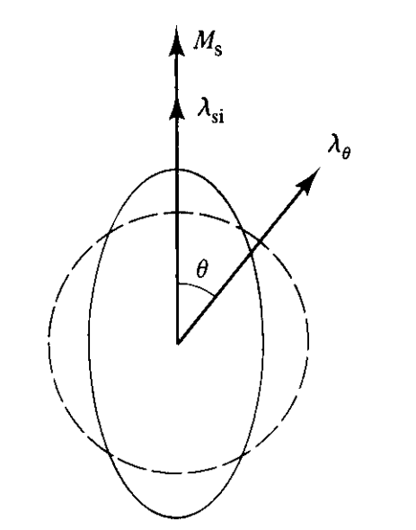
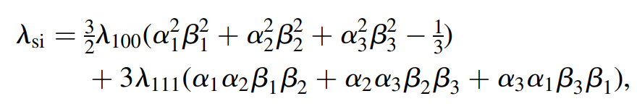

Mathematics - Magnetostriction
Magnetostriction from “ideal” demagnetized state:
For an isotropic material at an angle $θ$ to the magnetization direction:

Slide 2
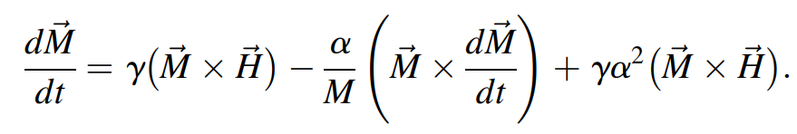
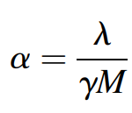

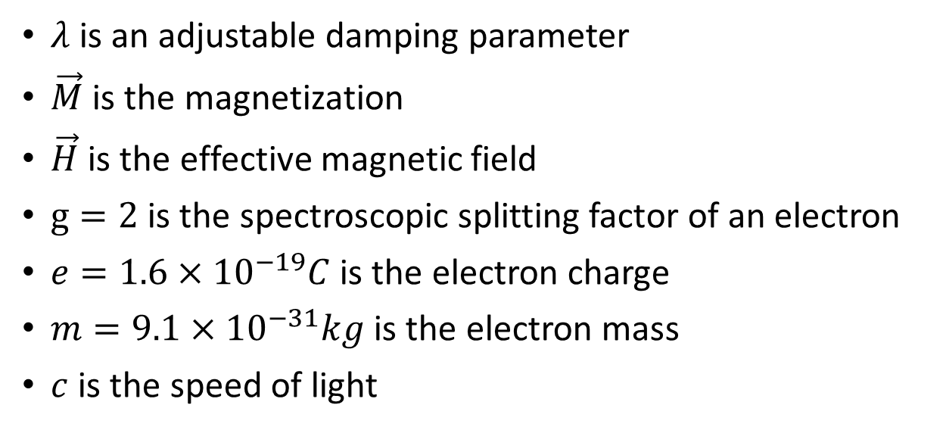
Mathematics – Magnetic Moment Dynamics
Landau-Lifshitz-Gilbert Equation:
$λ$ is an adjustable damping parameter
$\vec{M}$ is the magnetization
$\vec{H}$ is the effective magnetic field
$g=2$ is the spectroscopic splitting factor of an electron
$e=1.6×{10}^{−19}C$ is the electron charge
$m=9.1×{10}^{−31}kg$ is the electron mass
$c$ is the speed of light

Slide 3
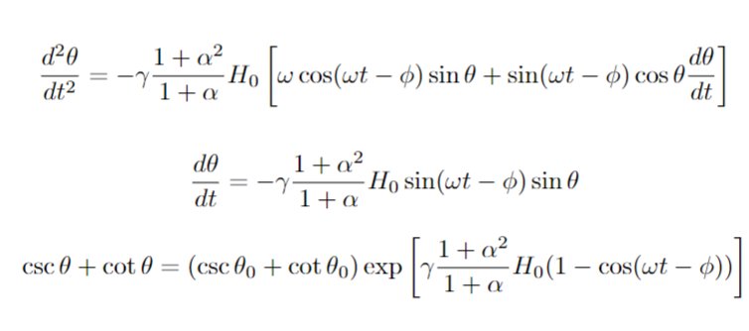
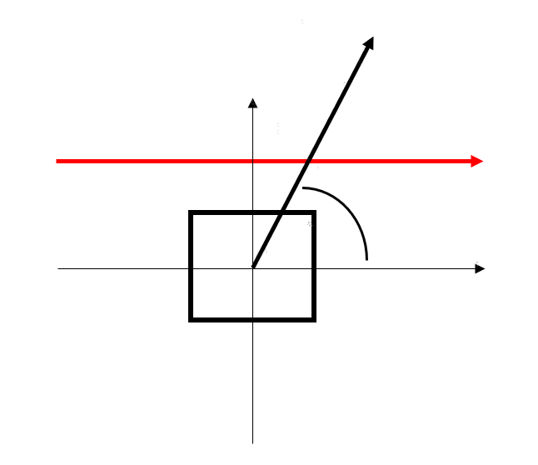





Model Equations and Assumptions
$$\vec{M}$$
$$y$$
$\vec{H}$
$$θ$$
$$x$$
Two-dimensional
Isotropic and Homogeneous material
Instantaneous magnetic moment response
Magnetic moment does not contribute to torque
Single domain (very small area - 0.1mm to 1mm dimensions)
Uni-directional, uniform, alternating magnetic field, which is in the same direction as the strain measurement axis.

Slide 4
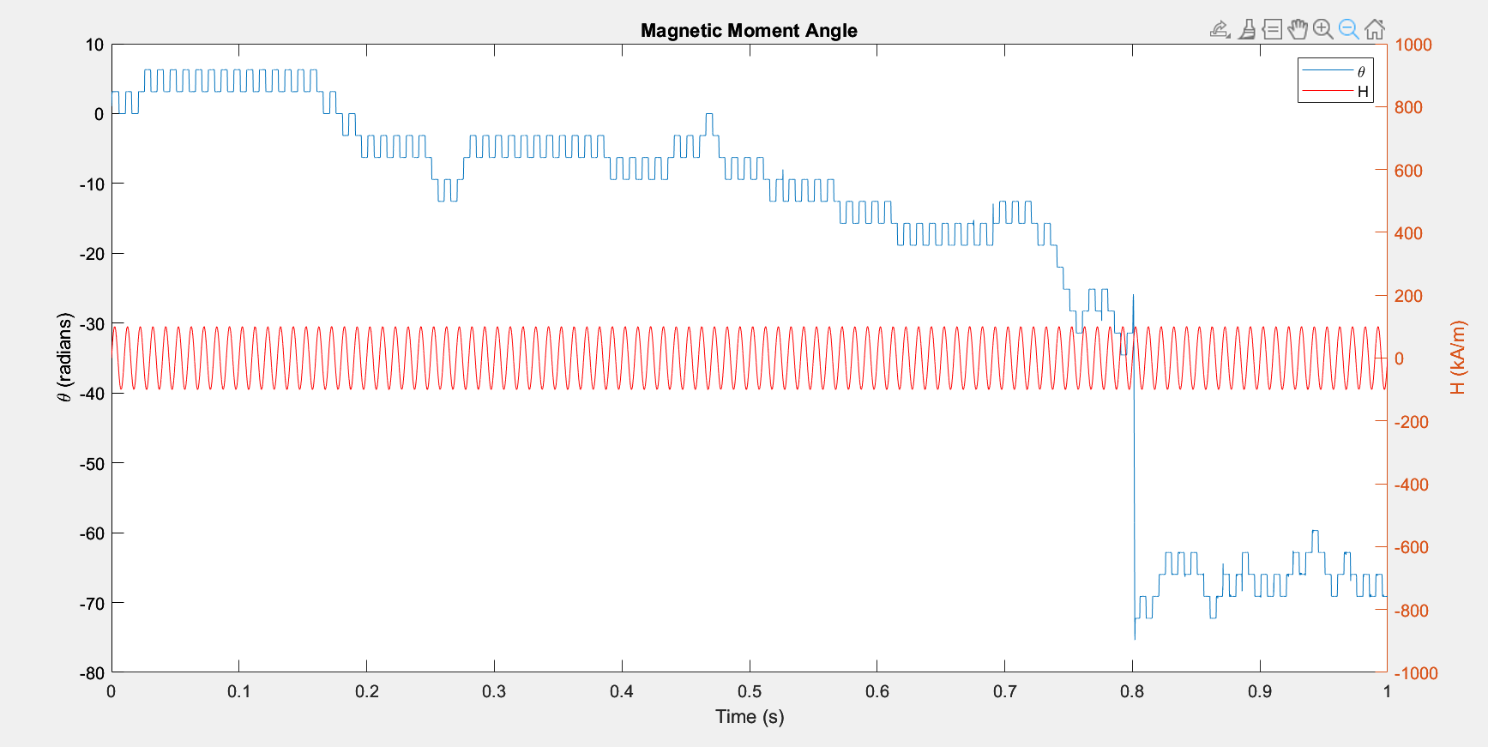

Slide 5
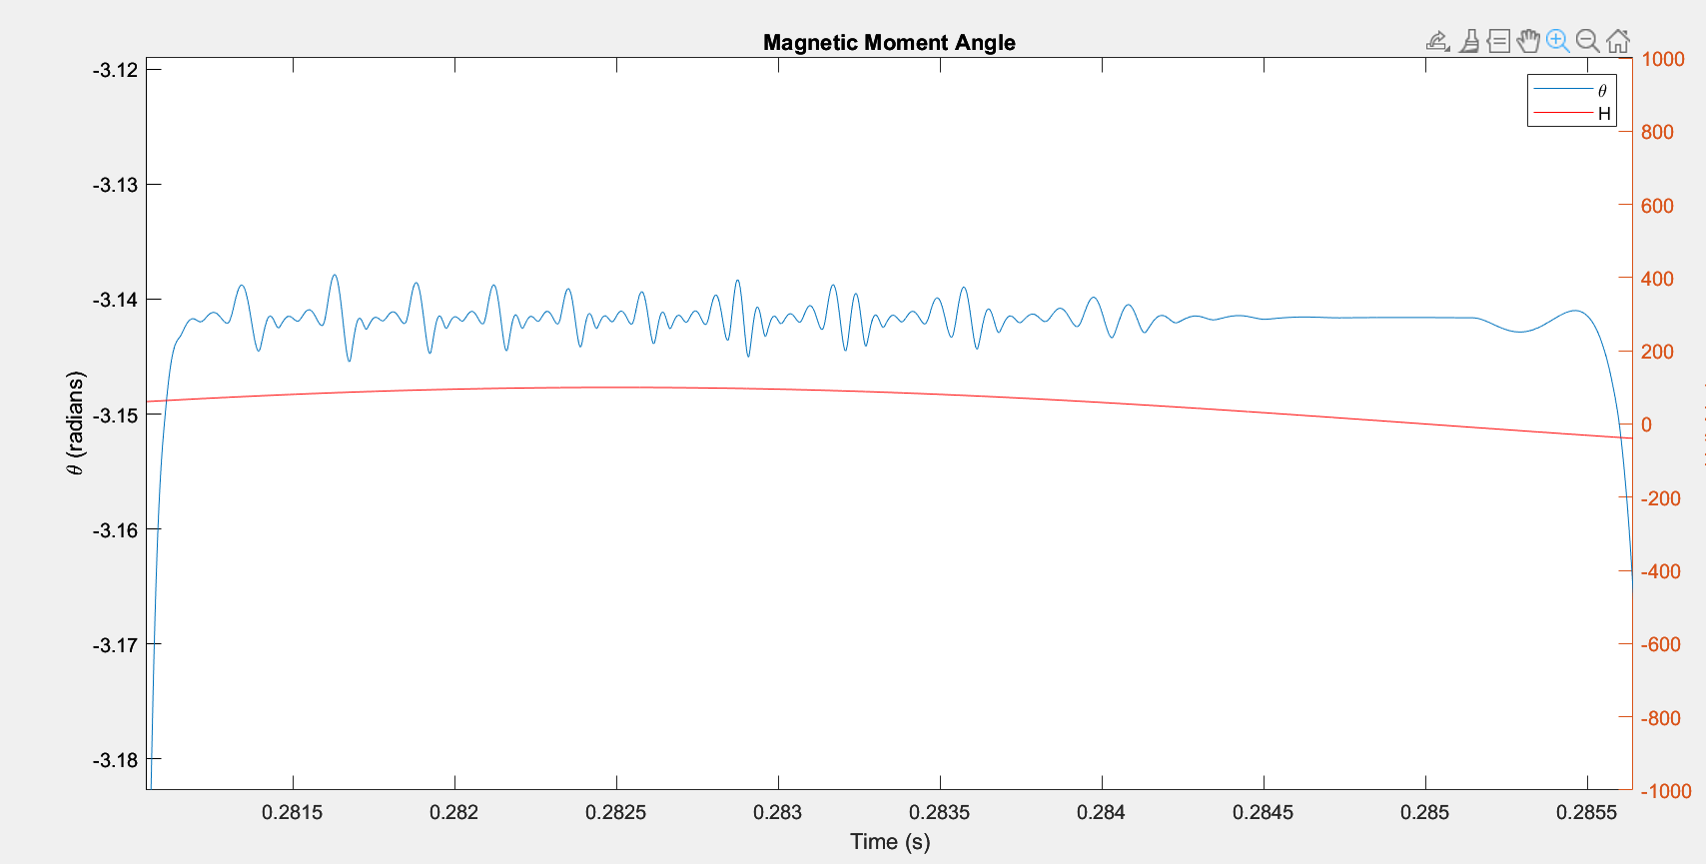

Slide 6
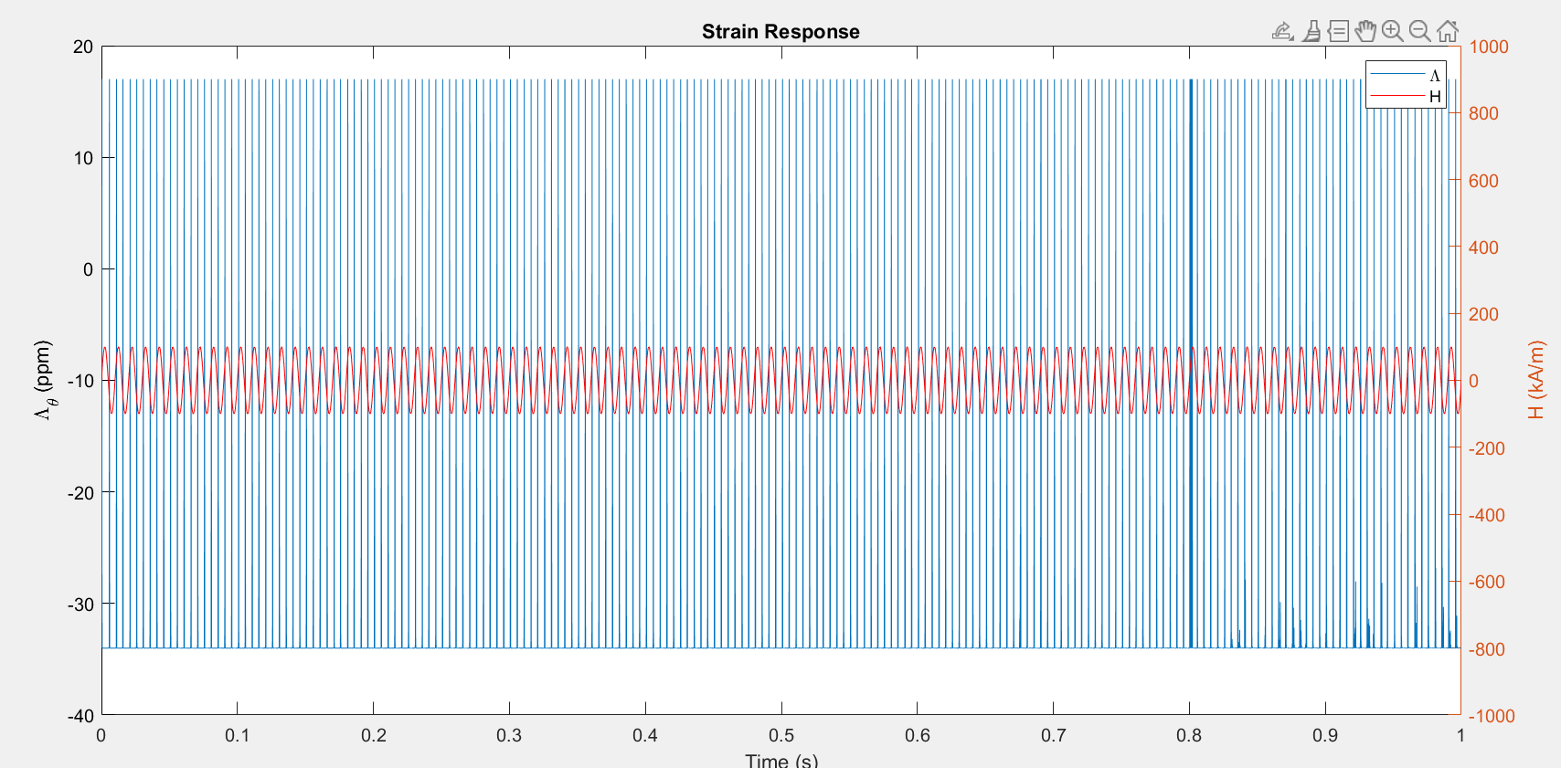

Slide 7
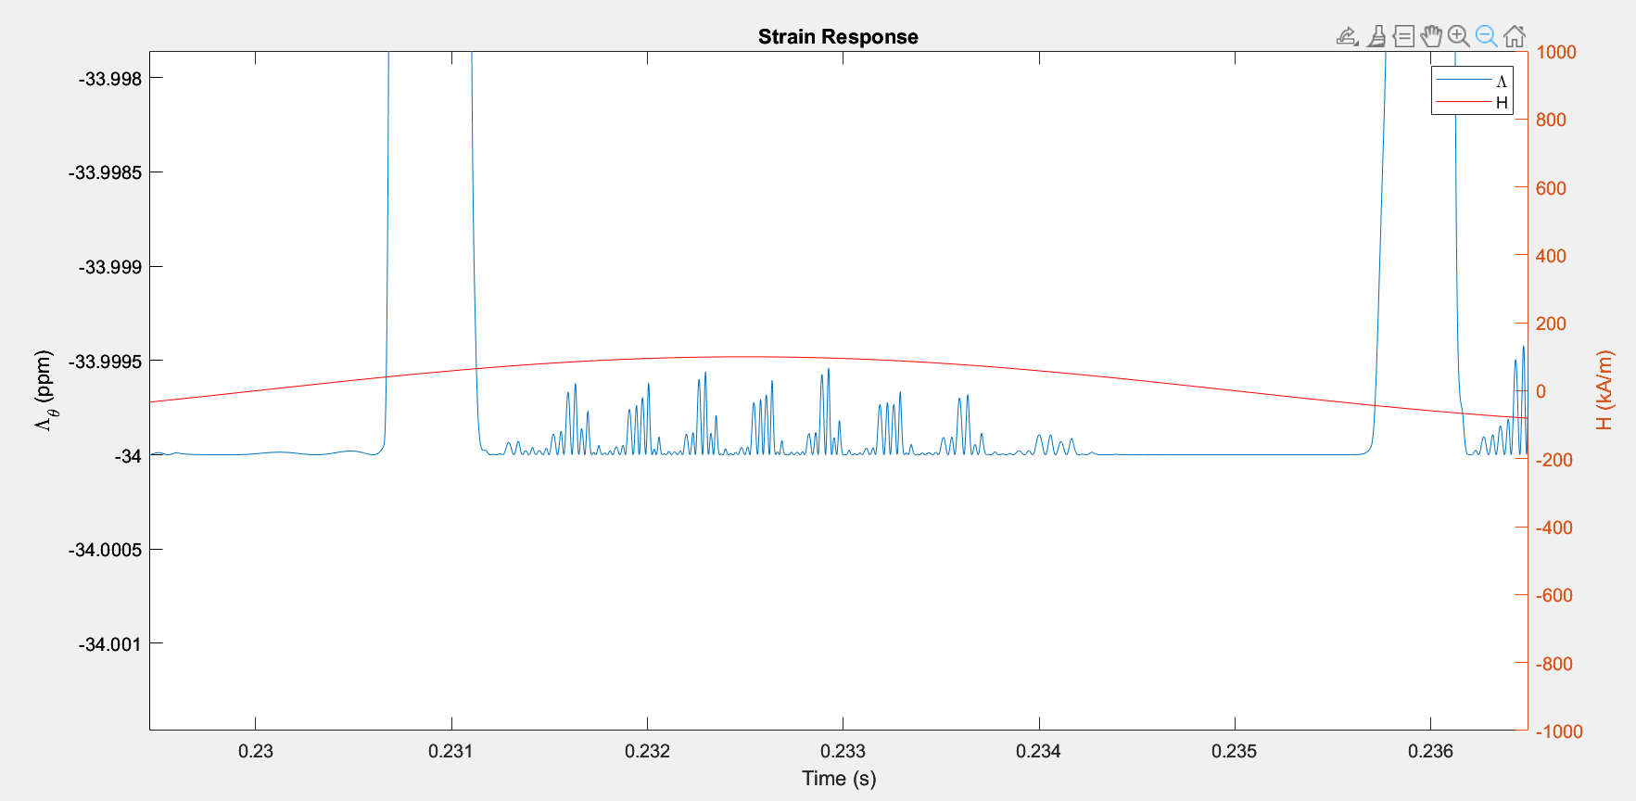

Slide 8
